Slide 1
Weekly report: Rotor Blade Design
Week number: 06
Date: 04.11.2025
Supervisor: Prof. Dr. rer.nat. Alois Schaffarczyk
Team members: Harsh Panchal, Kandarp Pathak, Jay Pandya, Daniyal Sikander
04.11.2025
1
Harsh Panchal
Rotor Blade Design/ Optimus Syria

Slide 2
List of contents
Blade Geometry
Cp vs Tip Speed Ratio Graph
Power Graph
04.11.2025
Harsh Panchal
Rotor Blade Design / Optimus Syria

Slide 3
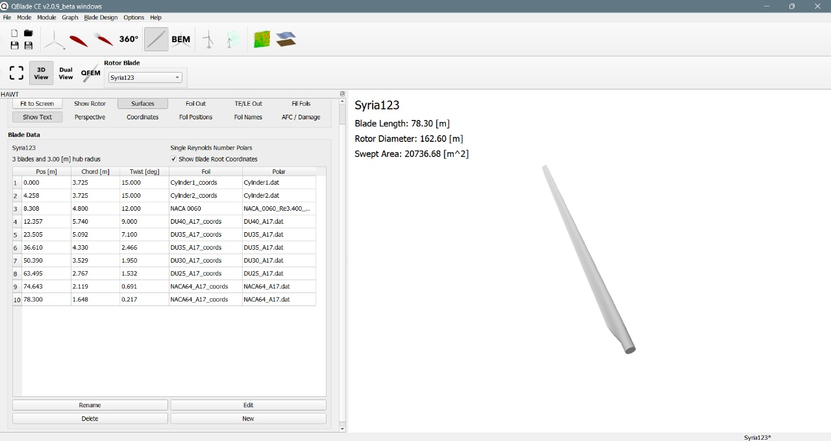
Blade Geometry
Source: Own Analysis MATLAB
04.11.2025
Harsh Panchal
Rotor Blade Design / Optimus Syria

Slide 4
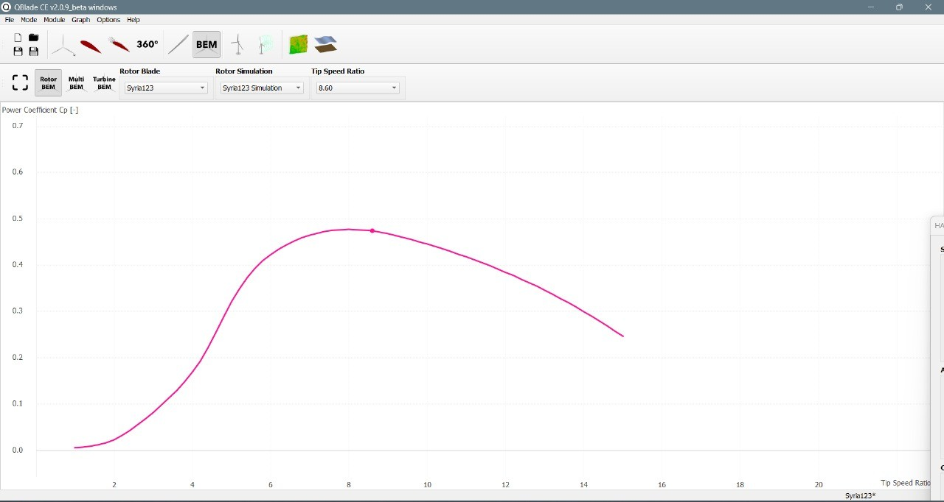
C_{p} vs Tip Speed Ratio Graph
Source: Own Analysis Q-blade
04.11.2025
Harsh Panchal
Rotor Blade Design / Optimus Syria

Slide 5
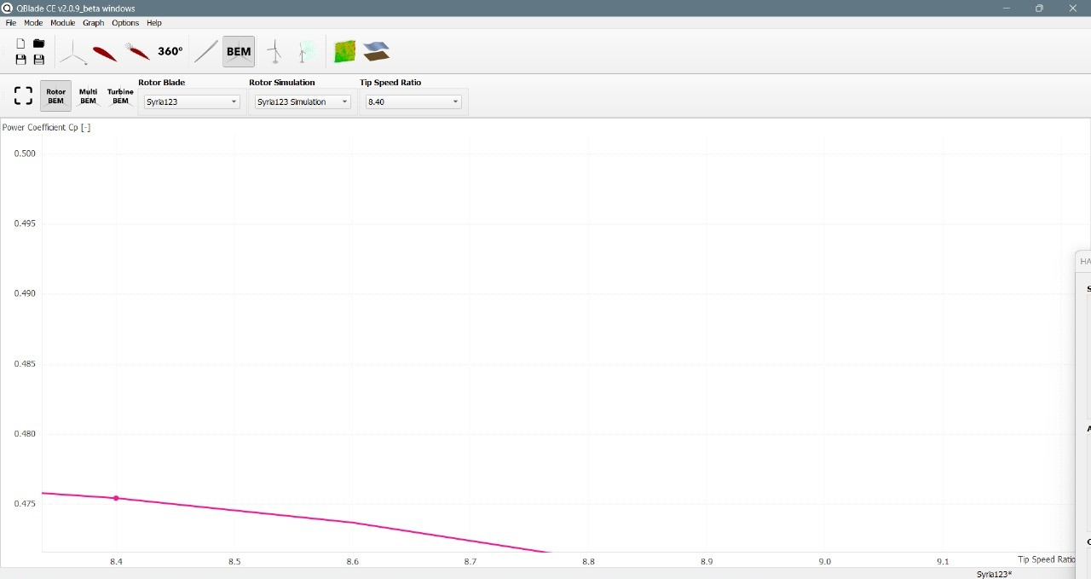
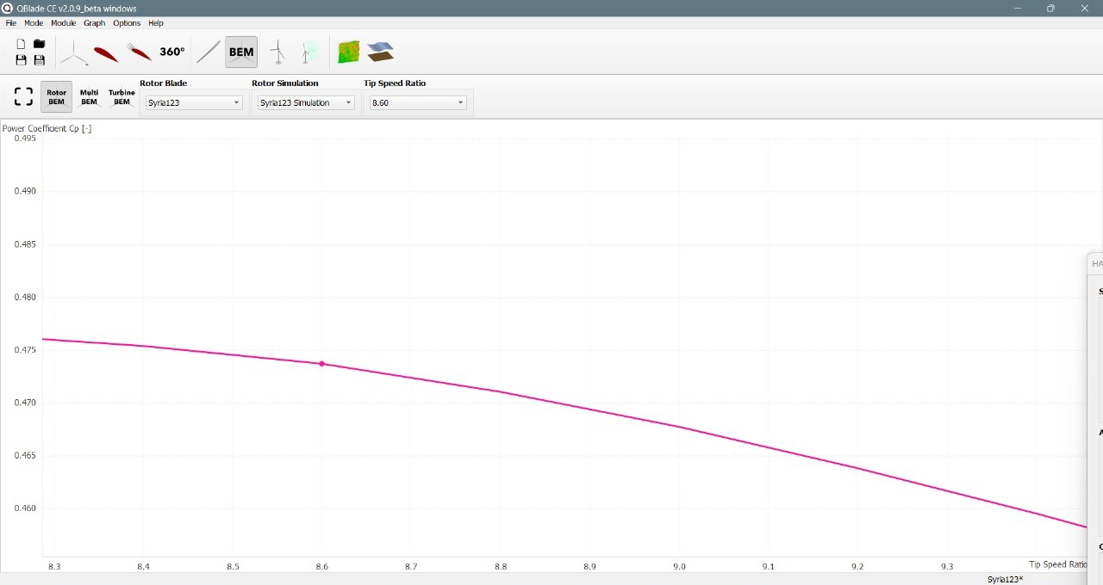
C_{p} vs Tip Speed Ratio Graph
Source: Own Analysis Q Blade
04.11.2025
Harsh Panchal
Rotor Blade Design / Optimus Syria

Slide 6
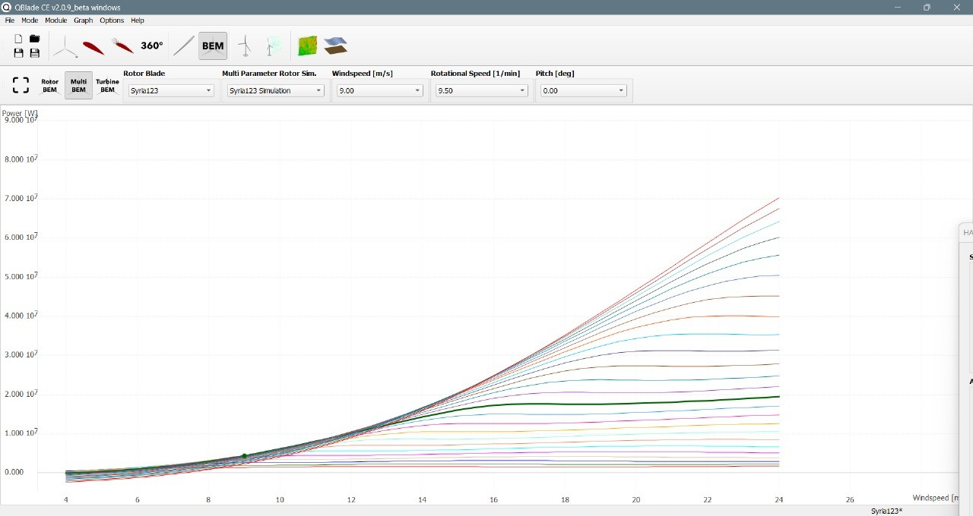
Power Graph
Source: Own Analysis Q Blade
04.11.2025
Harsh Panchal
Rotor Blade Design / Optimus Syria

Slide 7
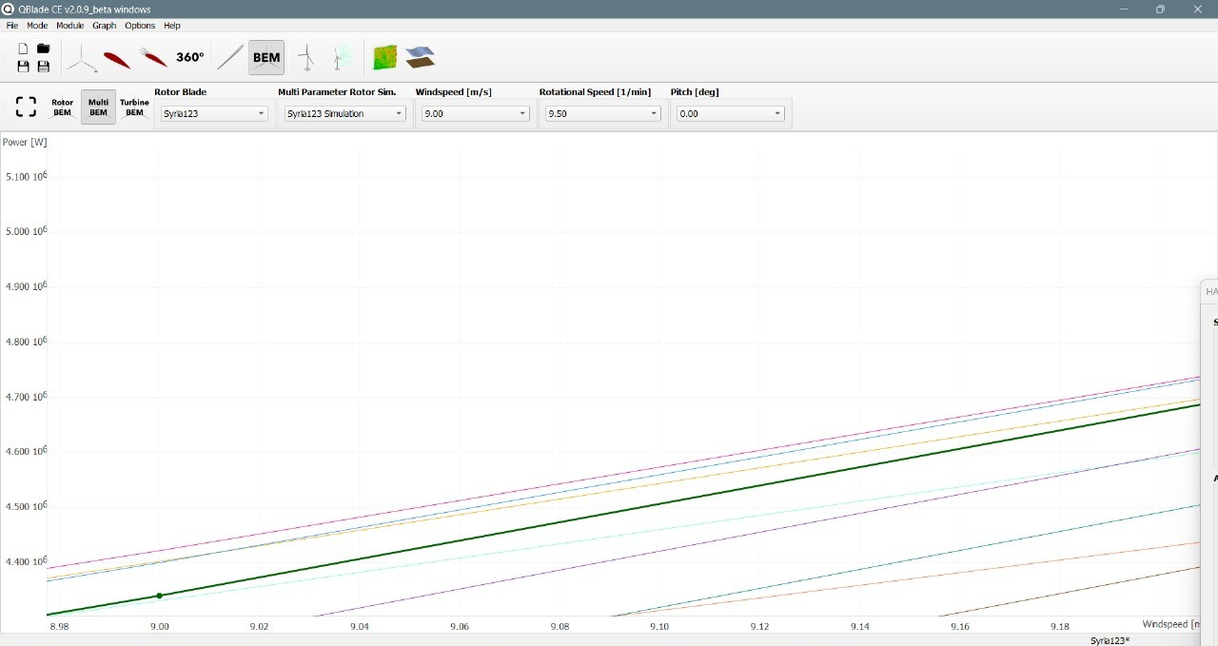
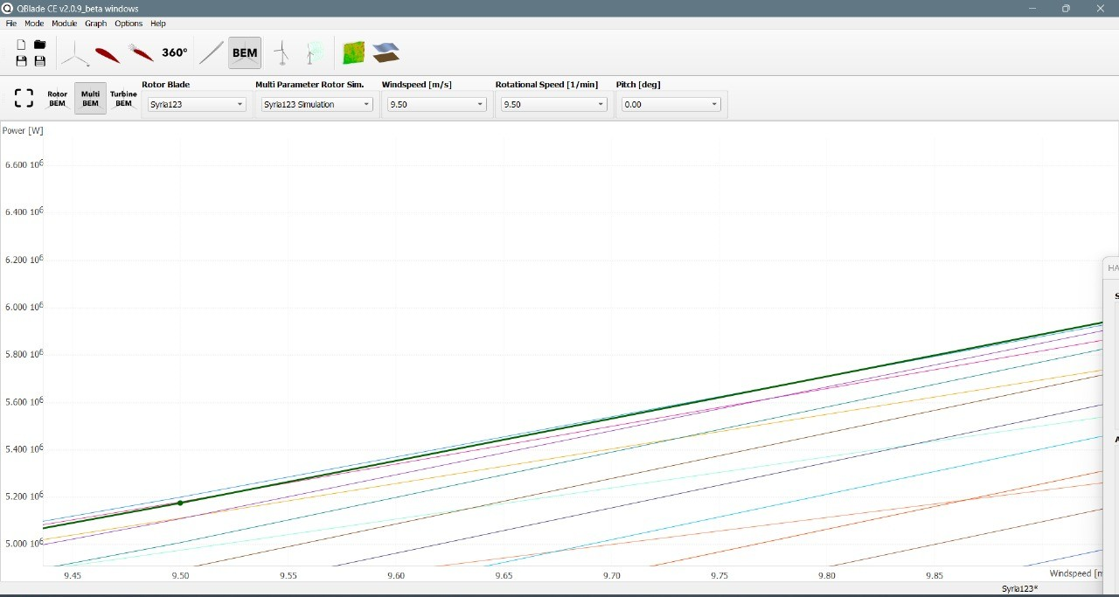
Power Graph
Source: Own Analysis Q Blade
04.11.2025
Harsh Panchal
Rotor Blade Design / Optimus Syria

Slide 8
Bibliography
Self Generated Content (01.11.2025)(20:00)
04.11.2025
Harsh Panchal
Rotor Blade Design / Optimus Syria

